Slide 1

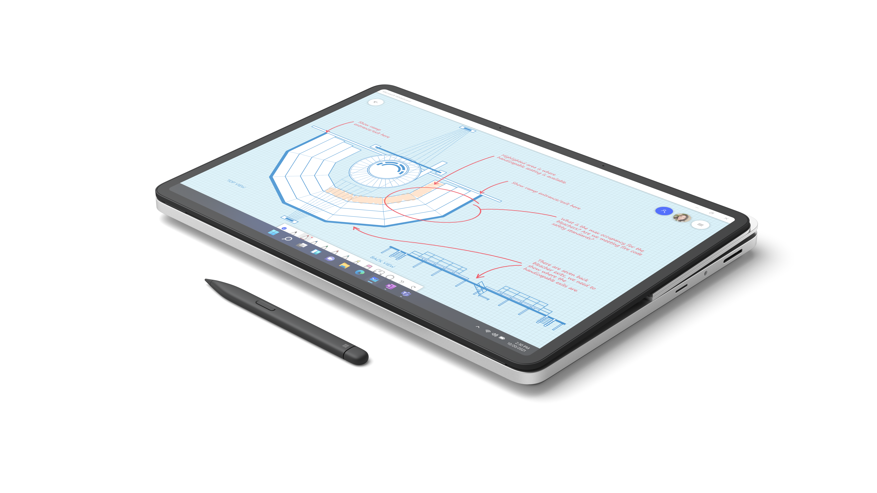
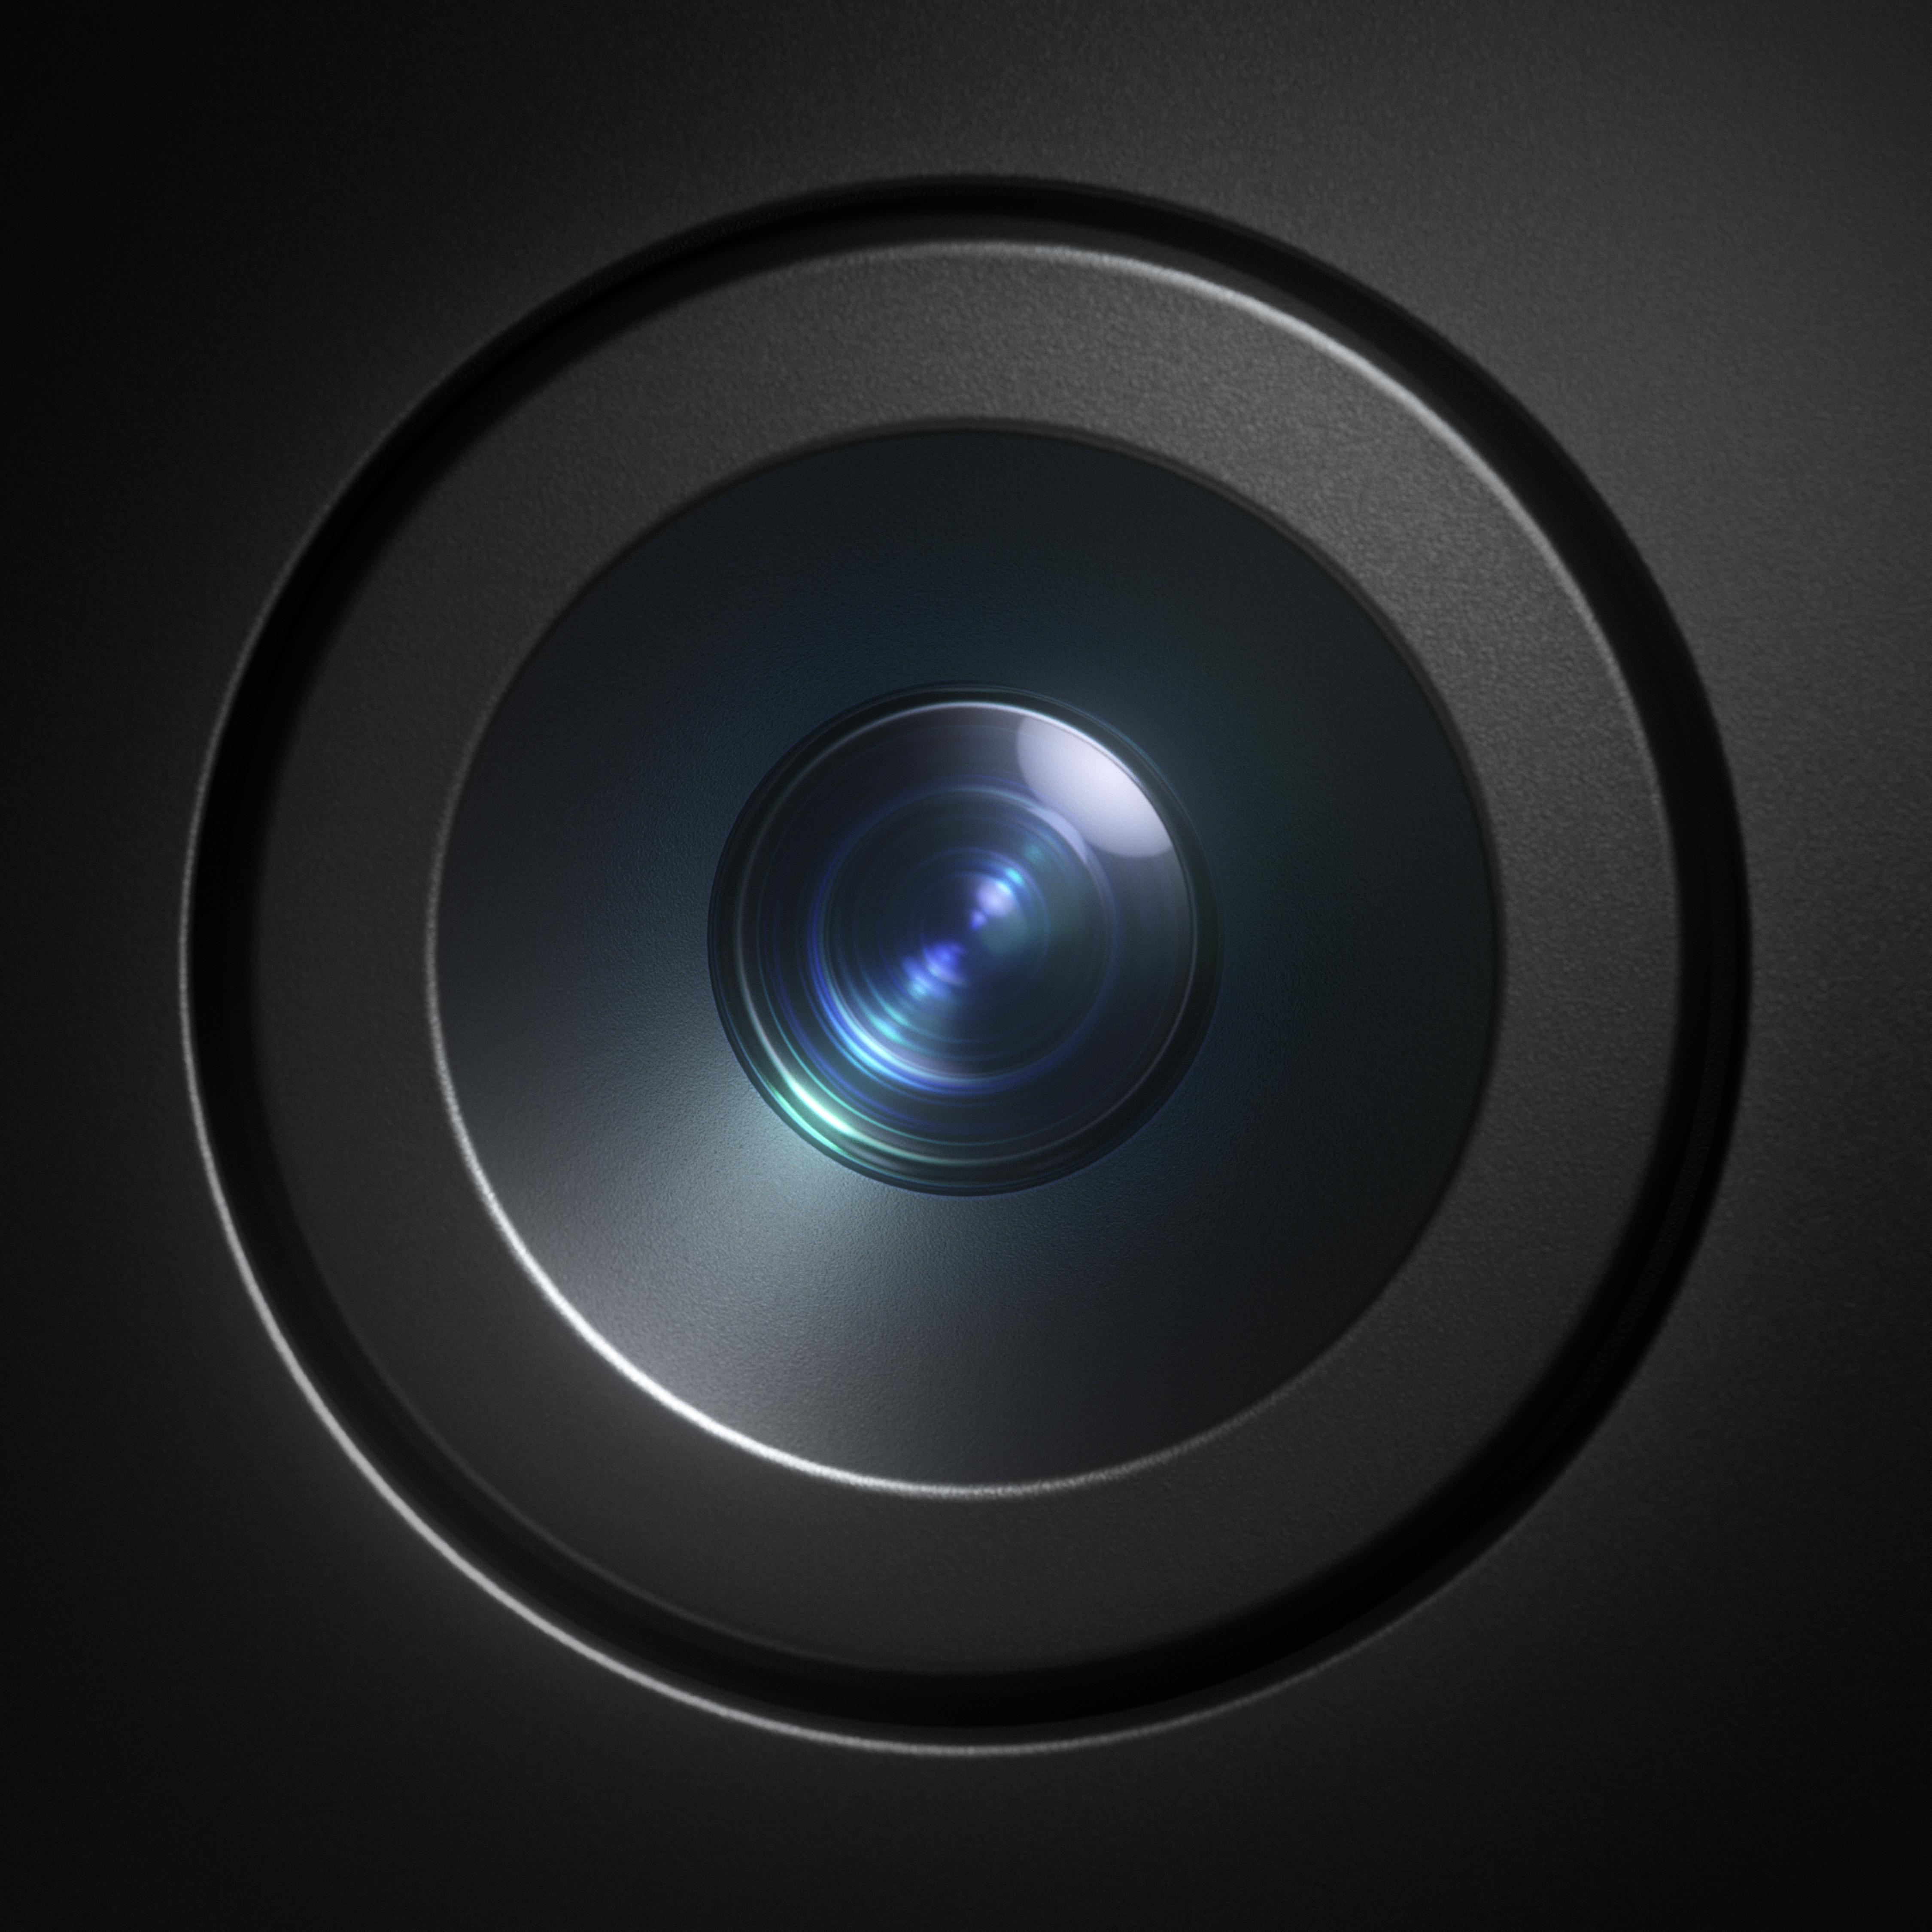
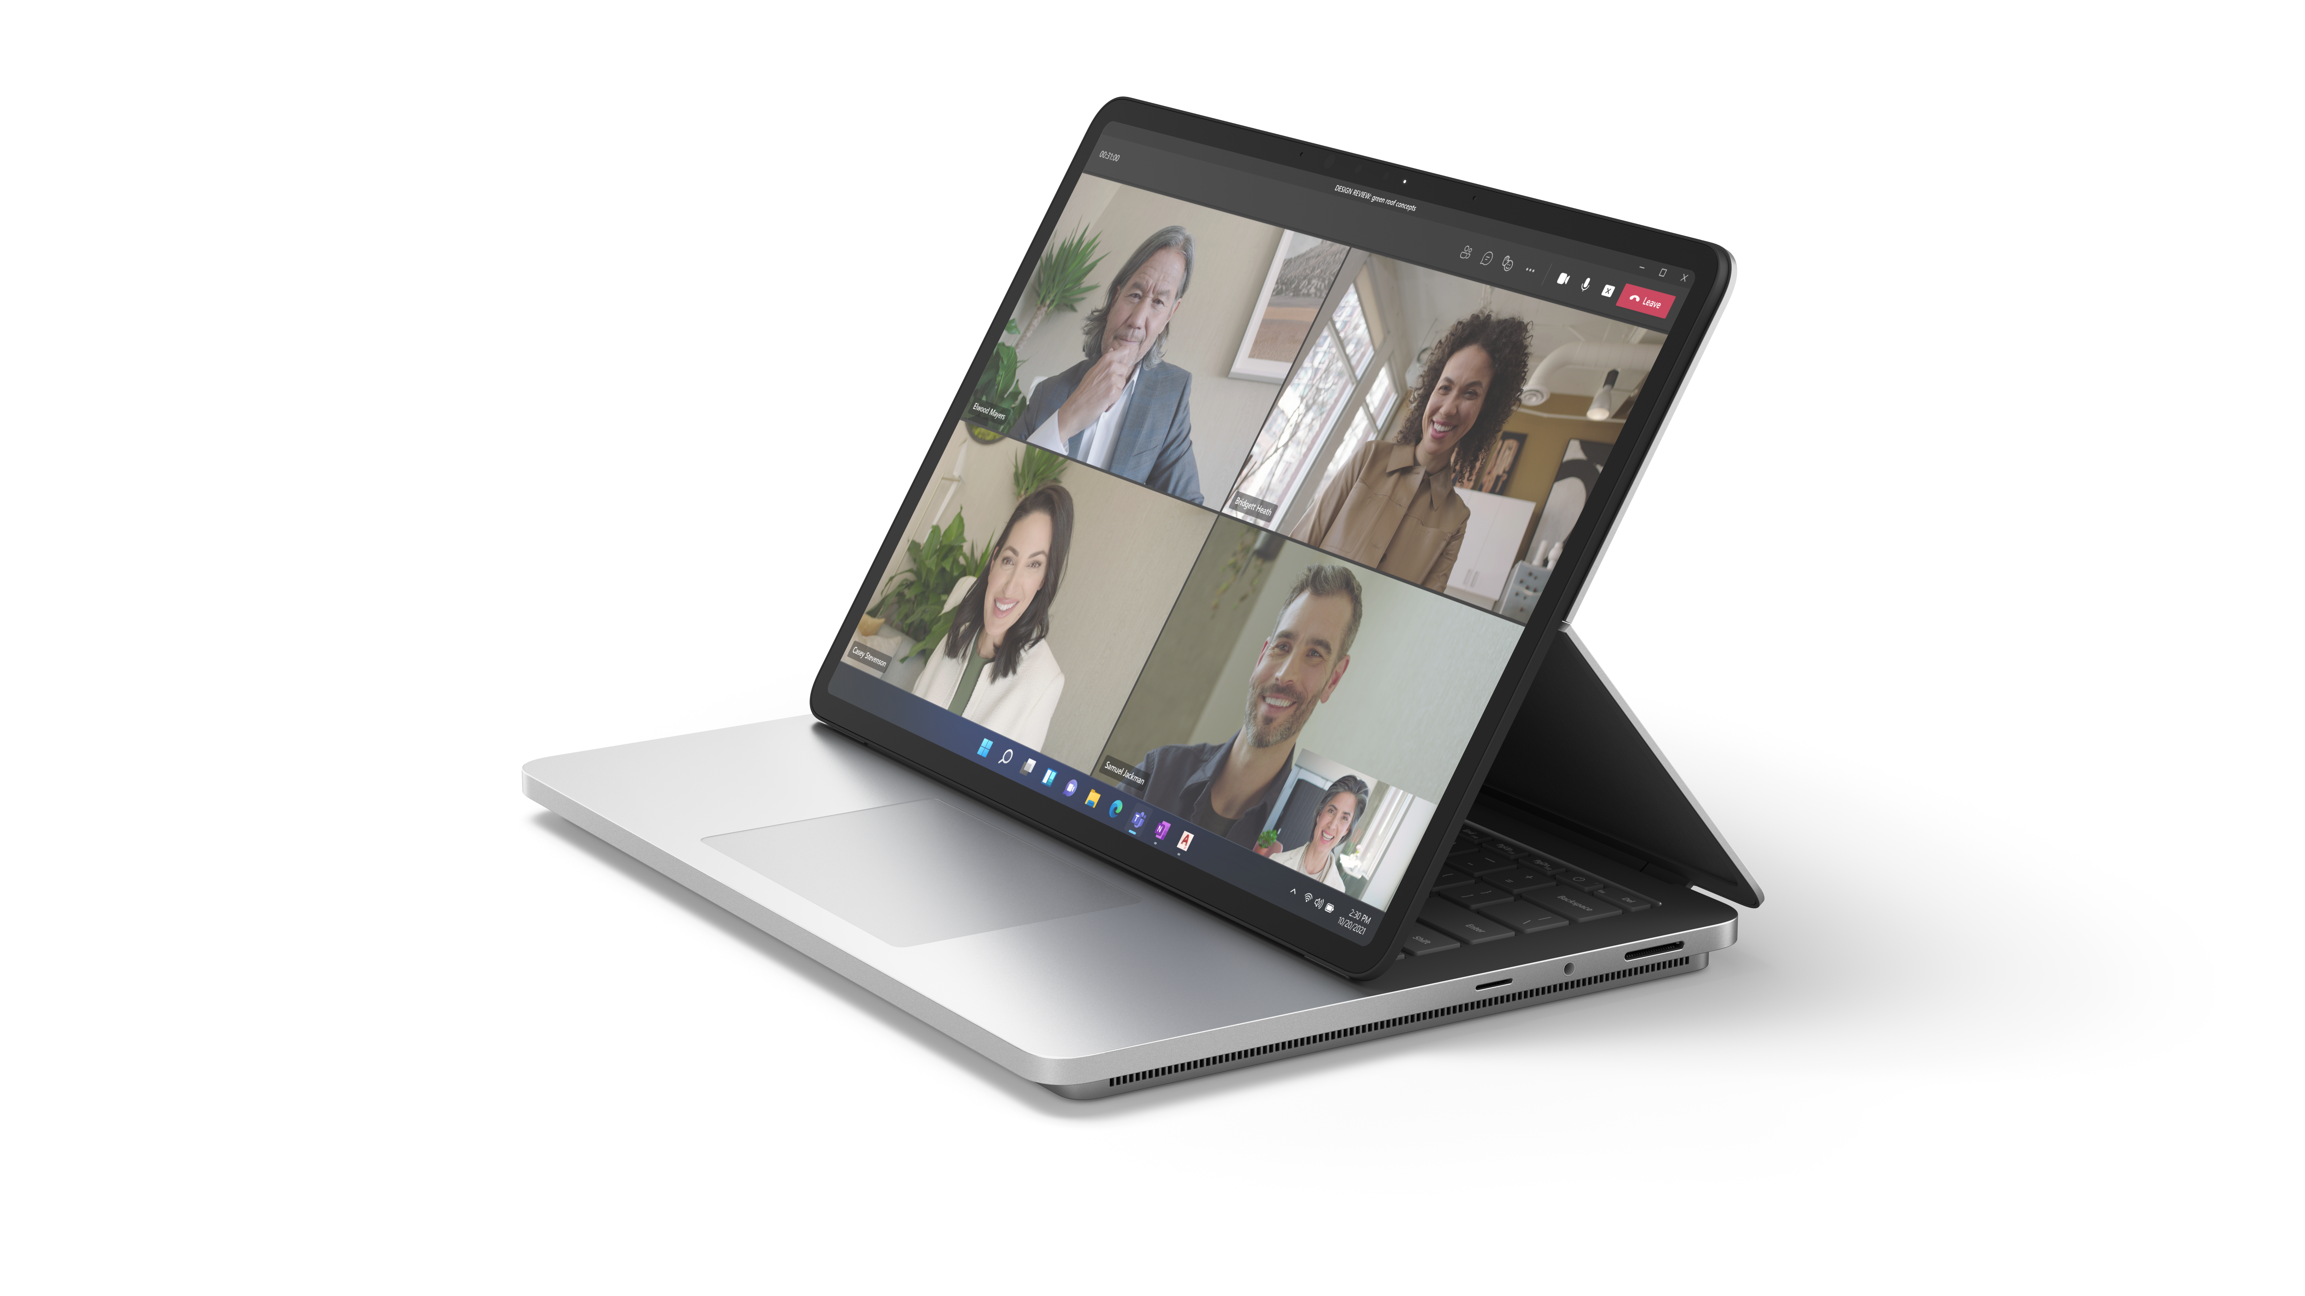
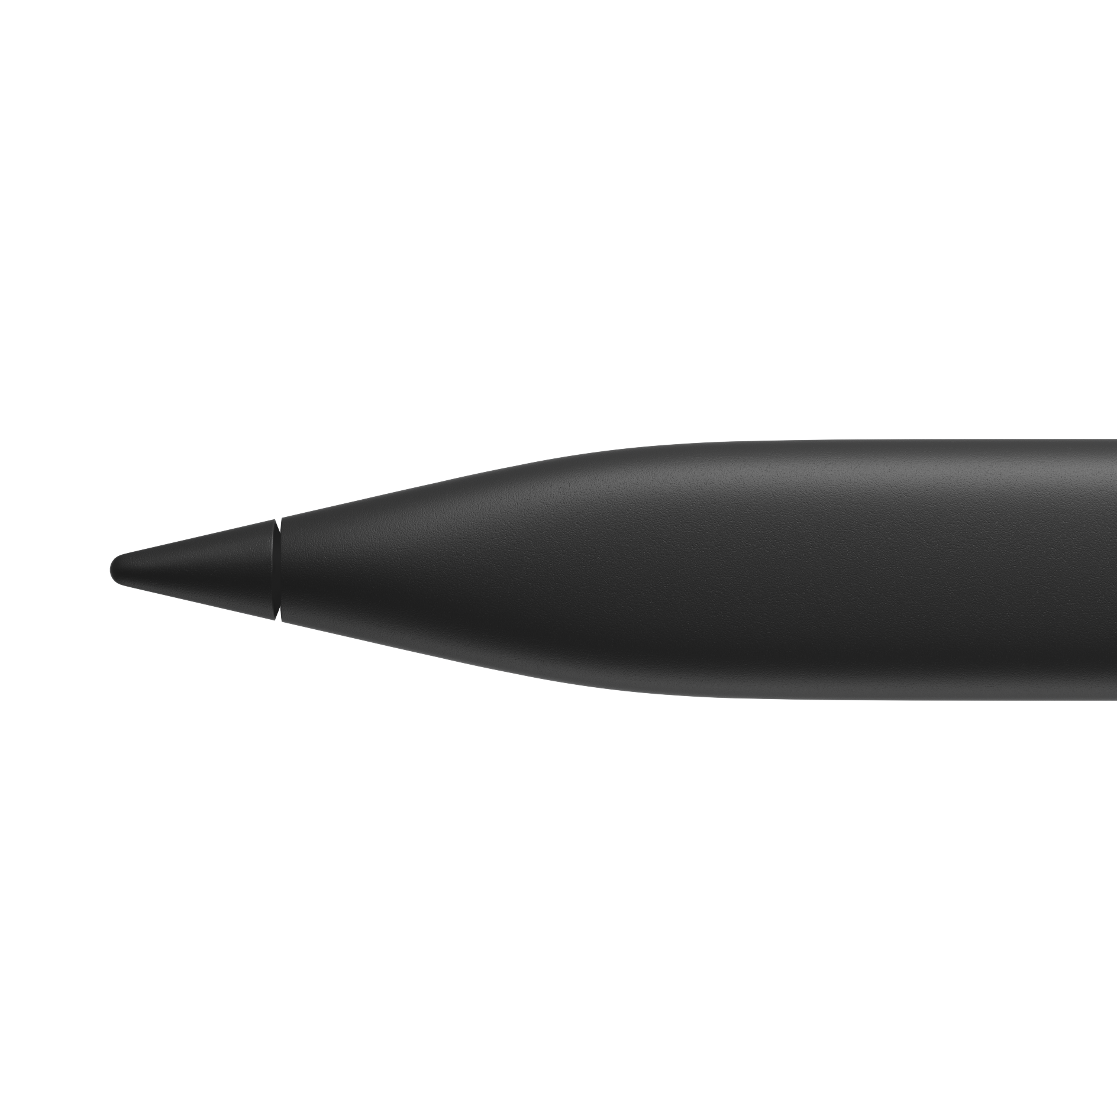
Microsoft Surface Laptop Studio 2
The versatility to create. The power to perform.
BENEFITS
Designed for
performance
Versatility for any challenge
Empower creativity
and collaboration
Deploy, manage, and stay secured from anywhere
Reimagine how your team gets work done with the most powerful Surface ever. Surface Laptop Studio 2 delivers enterprise-level performance in a revolutionary design that seamlessly
transitions between modes.
The most powerful
Surface delivers the performance for demanding tasks and intensive multitasking.
Give employees the
power to tackle any challenge, from
compiling data and multitasking to
sketching ideas.
Elevate productivity through a high-quality touchscreen, Studio Camera, speakers, mics, and all the ports your
workers need.
Give your IT team peace
of mind with Secured-core PCs and built-in, chip-to-cloud security¹ as they save time and budget through modern deployment and management.
IDEAL FOR:
Power professionals
Higher education faculty
STEM workers
New Studio Camera with a wide field of view and AI-powered features
Smooth and responsive writing with Surface Slim Pen 2²
Vibrant 14.4”³ PixelSense™ Flow touchscreen with a refresh rate up to 120hz
Over 2x more computing power and twice the graphics performance⁴
All-day productivity with all-day battery life⁵
Disclaimers
Dynamic woven hinge that seamlessly transitions between work modes
¹Some cloud-enabled features and functionality require paid subscription and/or qualifying license.
²Sold separately.
³Surface Laptop Studio 2 display has rounded corners within a standard rectangle. When measured as a standard rectangular shape the screen is 14.36” diagonally (actual viewable area is less).
⁴Available as an option on certain SKUs of Surface Laptop Studio 2.
⁵Battery life varies significantly based on device configuration, usage, network and feature configuration, signal strength, settings and other factors. See aka.ms/SurfaceBatteryPerformance for details.

